Slide 1
Biodiversity in US National Parks
By : Aksh Thakkar and Gayathri Dornadula

Slide 2
Project Objective
To analyze plant and animal species across various National Parks in the US.
Discover insights on species through visualizations to examine parameters like seasonality ,nativeness , occurrence and abundance.
The derived insights will have the below applications:
Guidelines for a visitor to a National Park.
Research Scientists can use the insights to analyze biodiversity across the US.
Appropriate Conservation Laws can be implemented in the Parks to protect the endangered species.

Slide 3

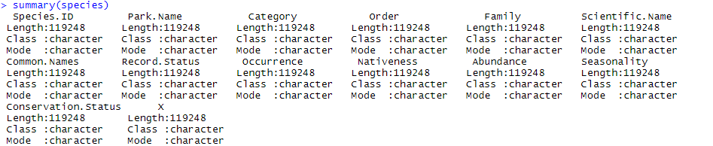
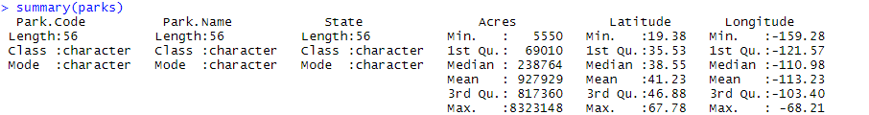
Data Description
Species - 119248 obs. of 14 variables
Parks – 56 obs. Of 6 variables

Slide 4
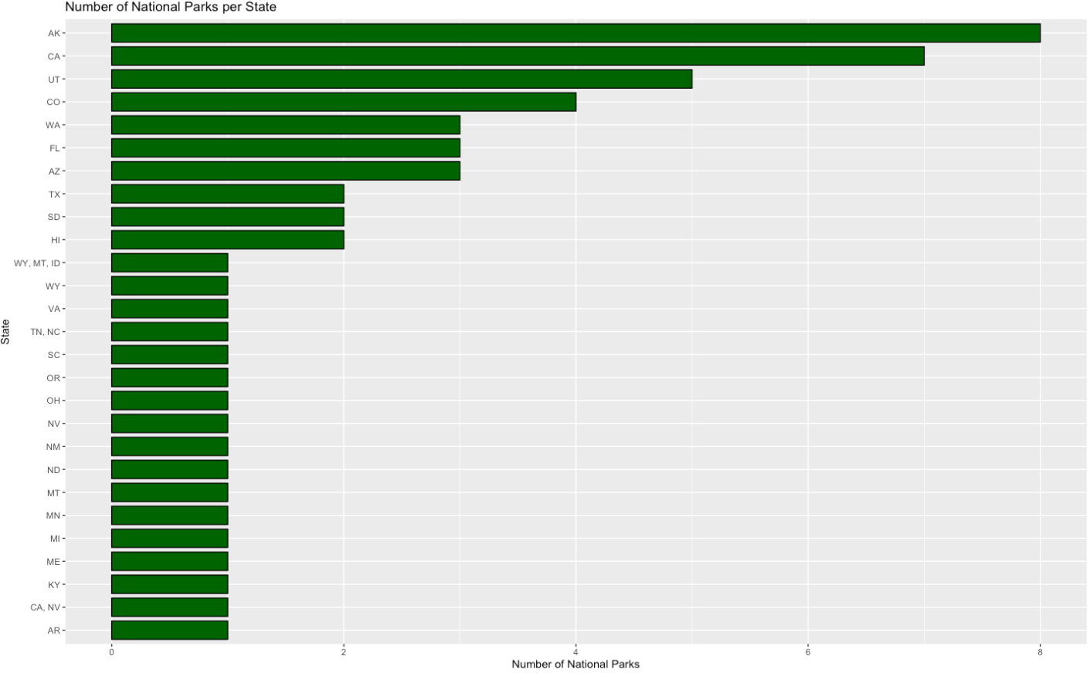
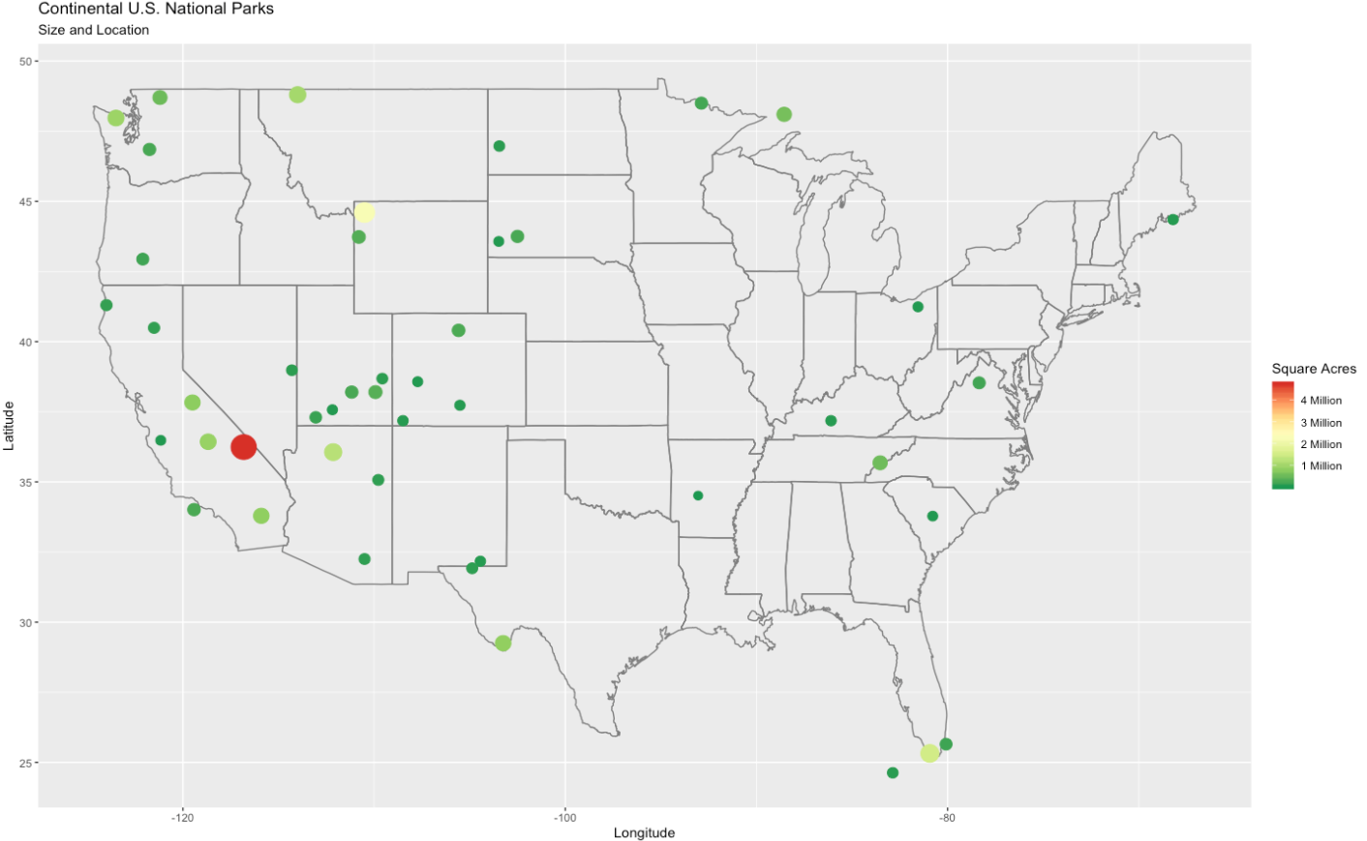
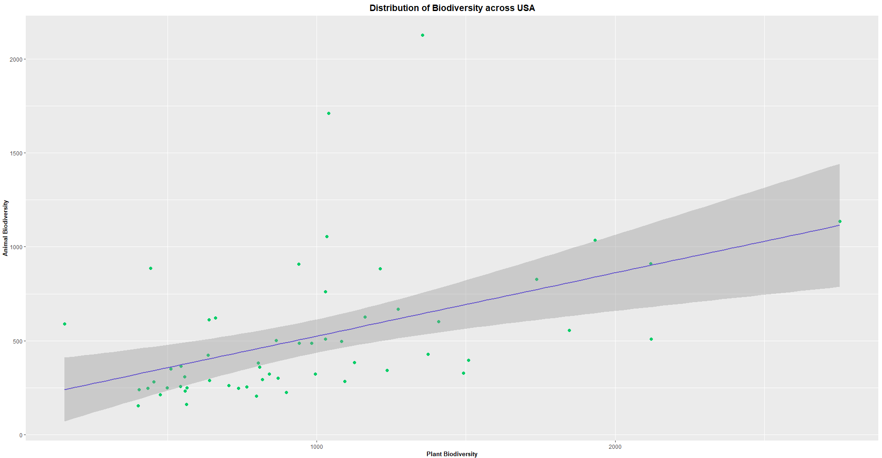
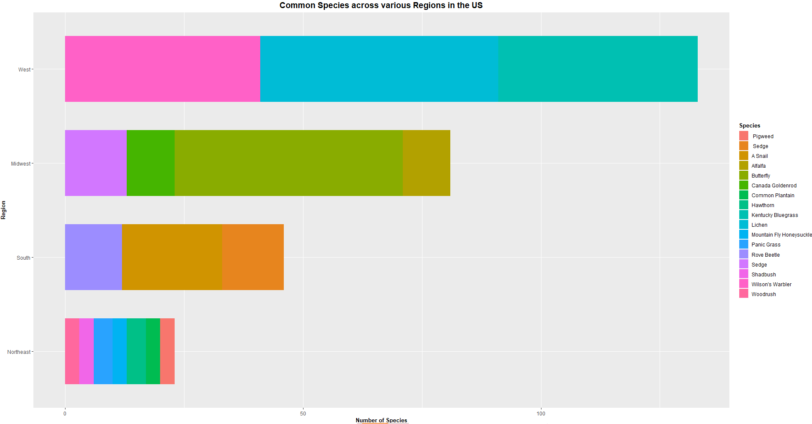
Count of National Parks by State
Size and Location of National Parks
Correlation between Animal and Plant Biodiversity
Common Species across Regions

Slide 5
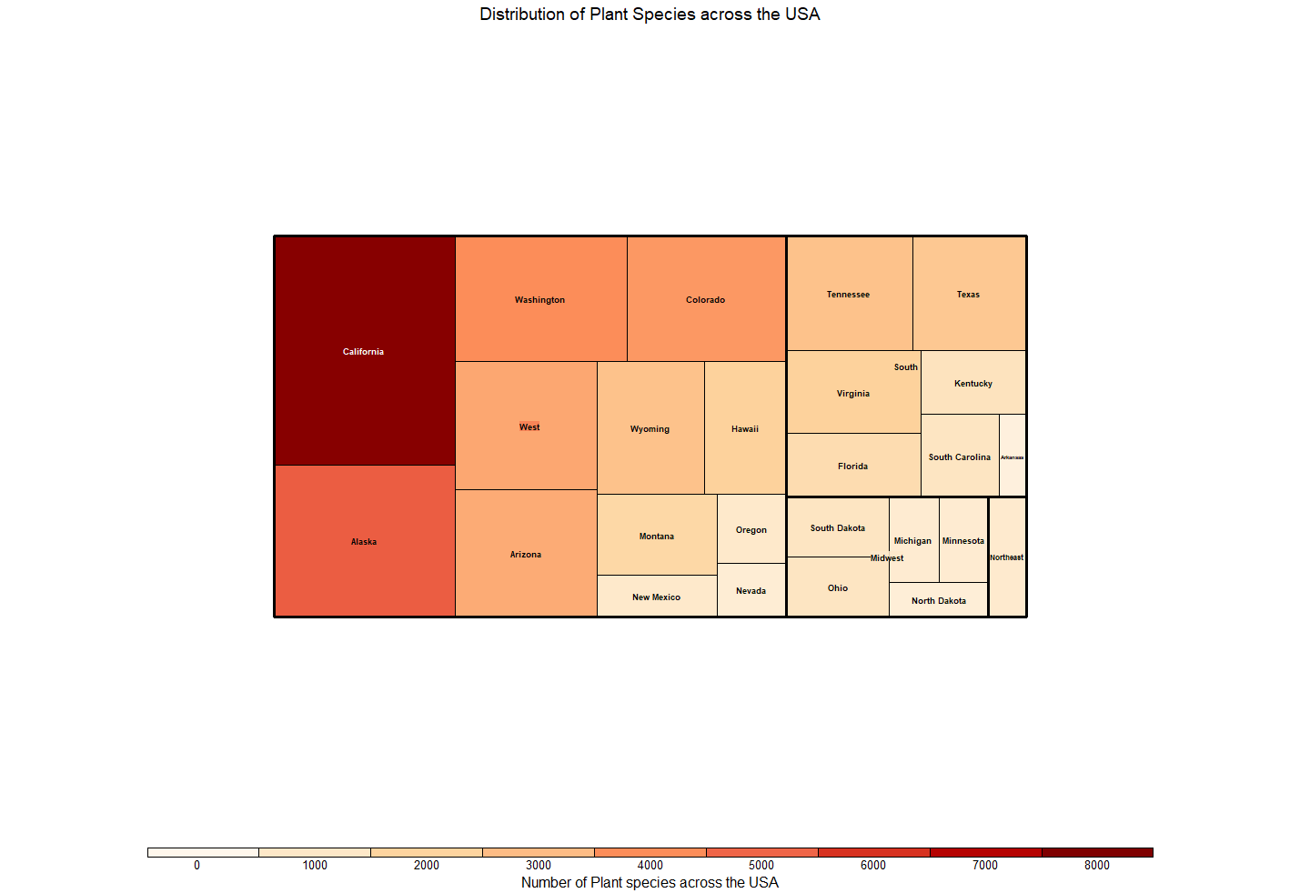
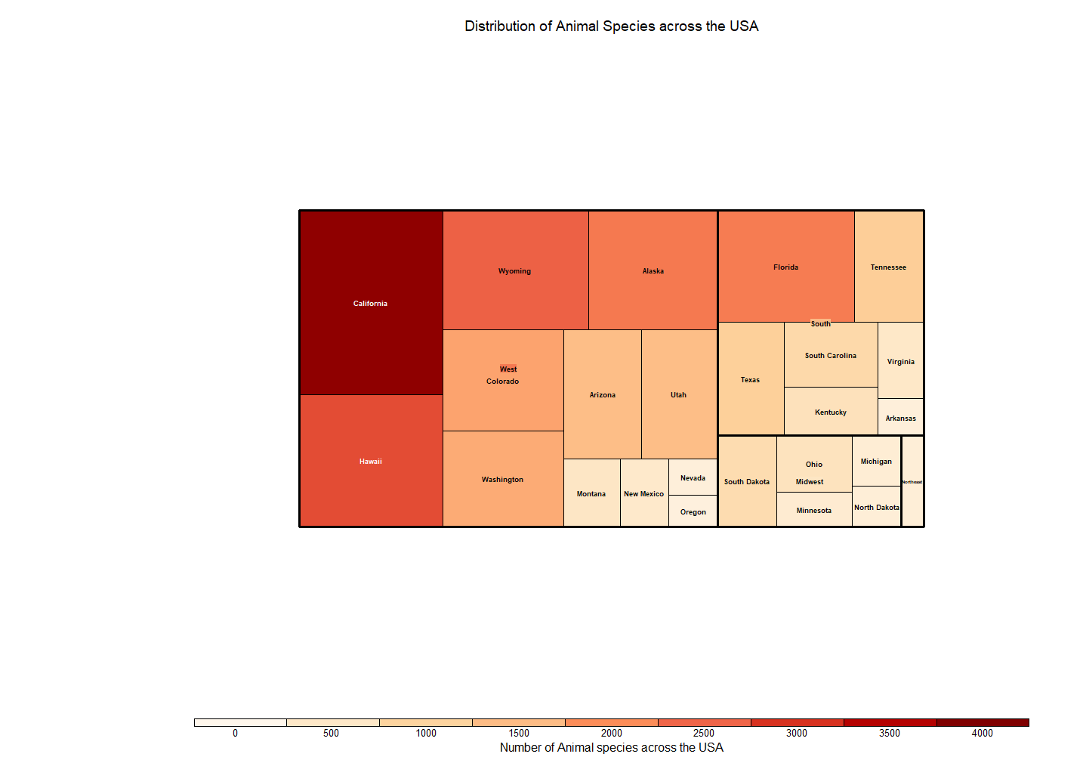
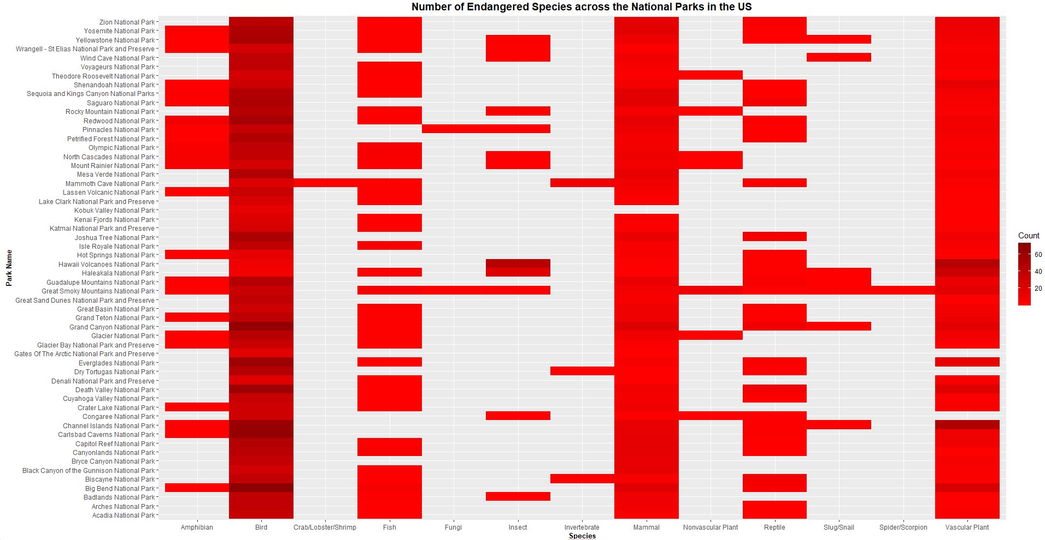
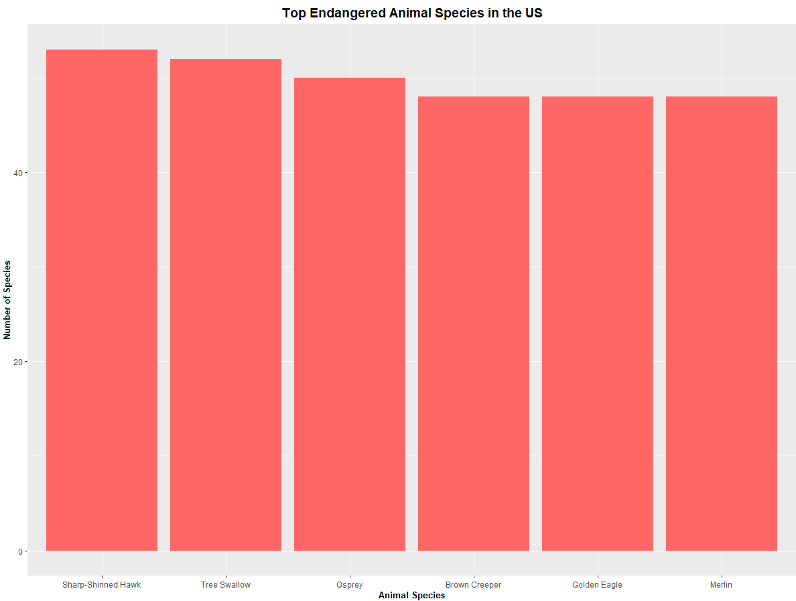
Distribution of Plant Species
Distribution of Animal Species
Endangered Species Analysis

Slide 6
Challenges
Data Wrangling to extract Species Common Names individually for Analysis.
Limited options for Graphs since most of the data is Categorical.

